Slide 1
A Perspective on
Action Plans on climate Change and
Vulnerability & Risk Assessment
US-India Partnership for Climate Resilience
Workshop on Development and Application of Downscaling Climate Projections
Manish Kumar Shrivastava
Fellow, TERI (New Delhi)
Indian Institute of Tropical Meteorology, Pune,
8 March 2017

Slide 2
Why Vulnerability and Risk Assessment?
Climate Risk Zones | Probable Risks | Key economic activities/assets/Resources
 |  | Agriculture | Water | Industry | Supply chain | population
Zone 1 | Fresh Water availability
 | Flood
 | Cyclone
Zone 2
Potential CLIMATE
RISKS and Intensity
P
R
E
P
A
R
E
D
N
E
S
S
Vulnerability hotspots | Location 1 | Location 2 | Location 3 | Location 4 | Location 5
Agriculture
Water
Industry
Supply chain
Human population
Adaptation options
Indicative cost of adaptation / Loss and damage

Slide 3
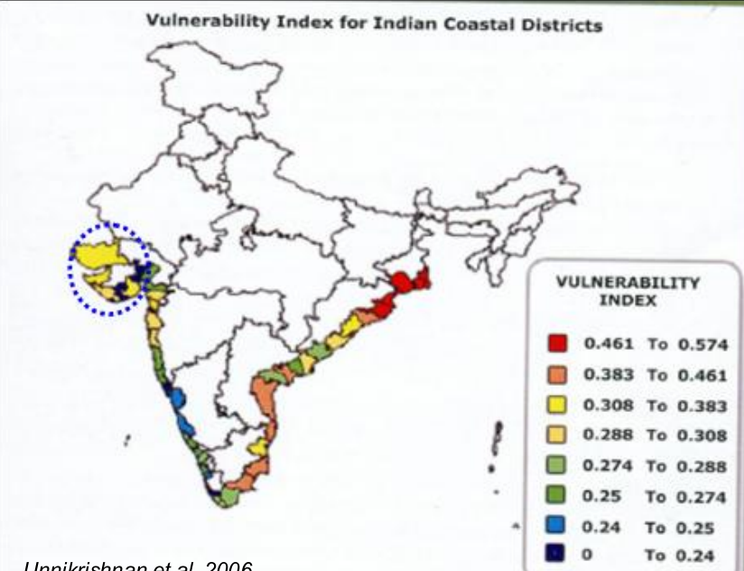

Slide 4
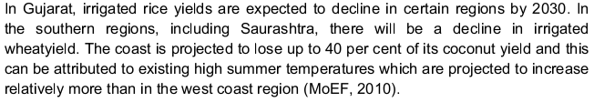
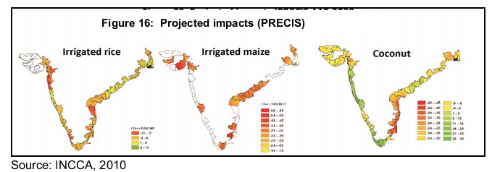

Slide 5
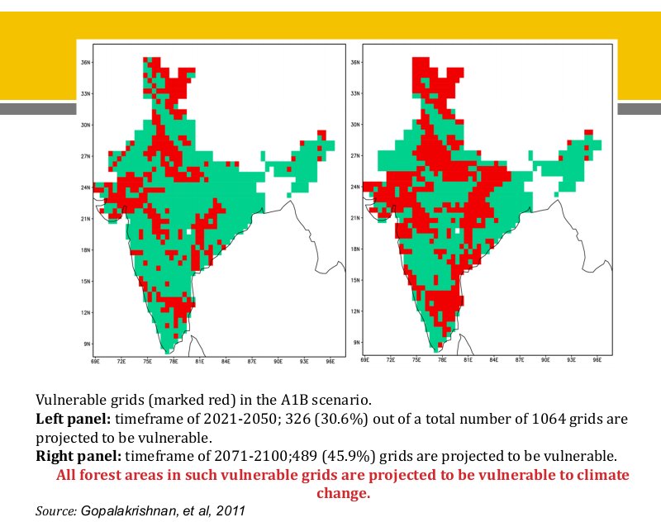

Slide 6
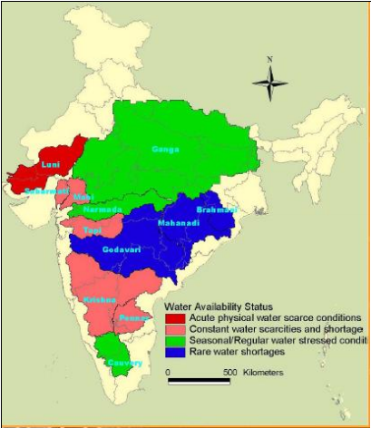
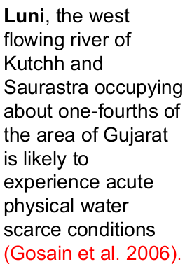

Slide 7
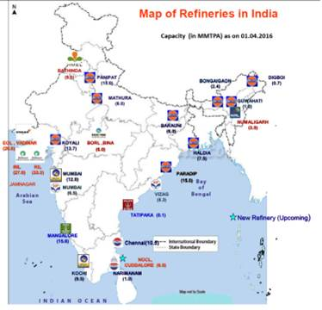
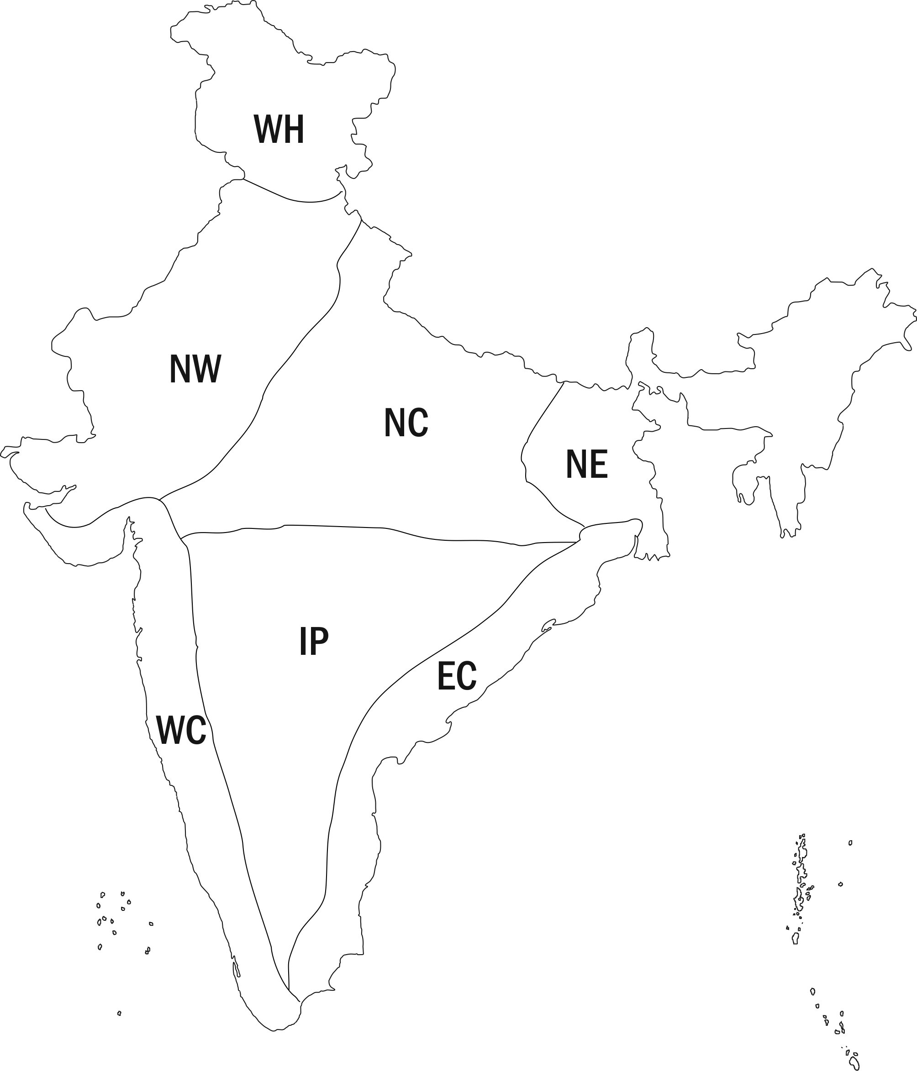
Example
Zones | Risk and uncertainties for future
West Coast (WC) and East Coast (EC) | Storm surges and cyclones and heavy rainfall events due to depressions and cyclones
North East (NE) | Intense rainfall events, thunderstorms, flooding
North West (NW) | Heat waves, extreme rainfall events
North- Central (NC) | Heavy rainfall events, heat waves, droughts
Interior Peninsula (IP) | Flood, droughts, heat waves and intense rainfall events

Slide 8
Responses in six states

Slide 9
Inputs for governance reforms
Food – Water – Energy – Climate Change Linkages
Governance of each sector is different
Integrated downscaled analysis
➔ Integrated and effective cross-sectoral governance strategies

Slide 10
Maharashtra SAPCC: Methodology
High resolution climate change modelling
Sector-specific assessment and adaptation strategies
District-level vulnerability index and identification of six vulnerability hotspot districts
Household-level surveys with farming and fishing households in six vulnerability hotspot districts
Stakeholder consultations and preparation of district-level adaptation action for six vulnerability hotspot districts and Mumbai Metropolitan Region
Validation of findings and discussion of adaptation strategies with state line departments and district administration.

Slide 11
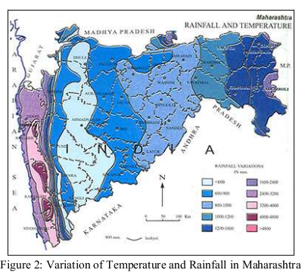
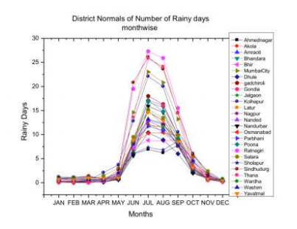
Rainfall variations in Maharashtra

Slide 12
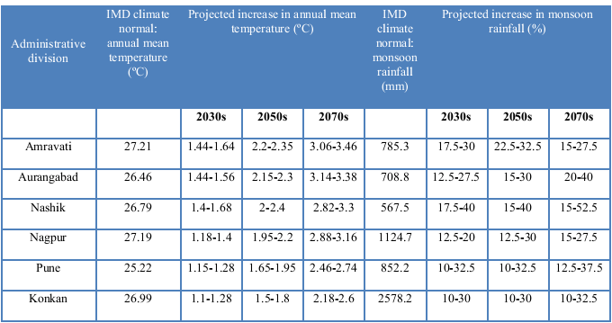
Division wise climate change projections
Note: The projection for the 2030s is the average of projections for the period 2021-2040. Similarly, the projection for the 2050s in the average of projections for 2041-2060 and that for the 2070s is the average of projections for 2061-2080.

Slide 13
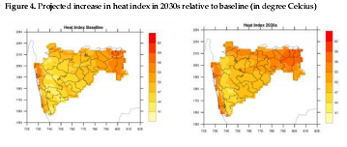
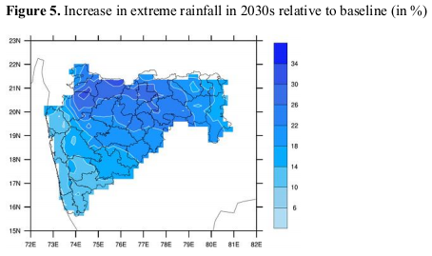
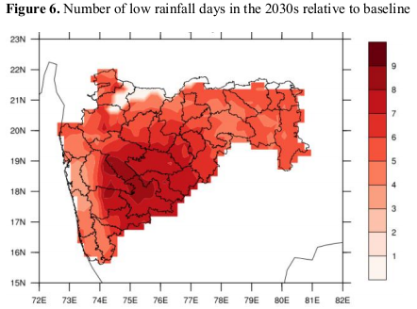
Temperature/ Rainfall projections
HadRM3P model in the PRECIS Regional Climate Modelling System

Slide 14
Maharashtra: Impacts
Increase in temperature leads to decline in yield
Increase in CO2 concentration leads to improvement in yield but get nullified due to temperature rise
Likely increase in pest incidents due to increased rainfall
Increased rainfall if managed properly can be beneficial
Increase in average number of days that are conducive to malaria transmission
Faster rate of parasite development at higher temperatures
Increased risk of water borne diseases
Reduced availability of fresh water due to saltwater intrusion

Slide 15
Thank You

